Slide 1
Logistic Regression
The content of these slides has been gathered from various online sources. We extend our sincere gratitude to everyone who has contributed their work.

Slide 2
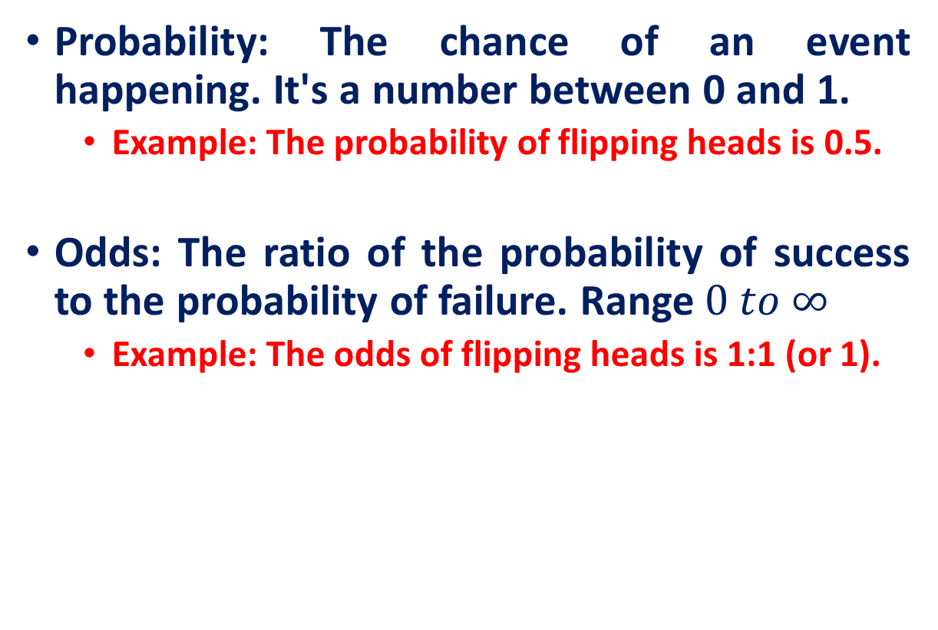
Probability and Odds
Probability: The chance of an event happening. It's a number between 0 and 1.
Example: The probability of flipping heads is 0.5.
Odds: The ratio of the probability of success to the probability of failure. Range $0 to ∞$
Example: The odds of flipping heads is 1:1 (or 1).

Slide 3
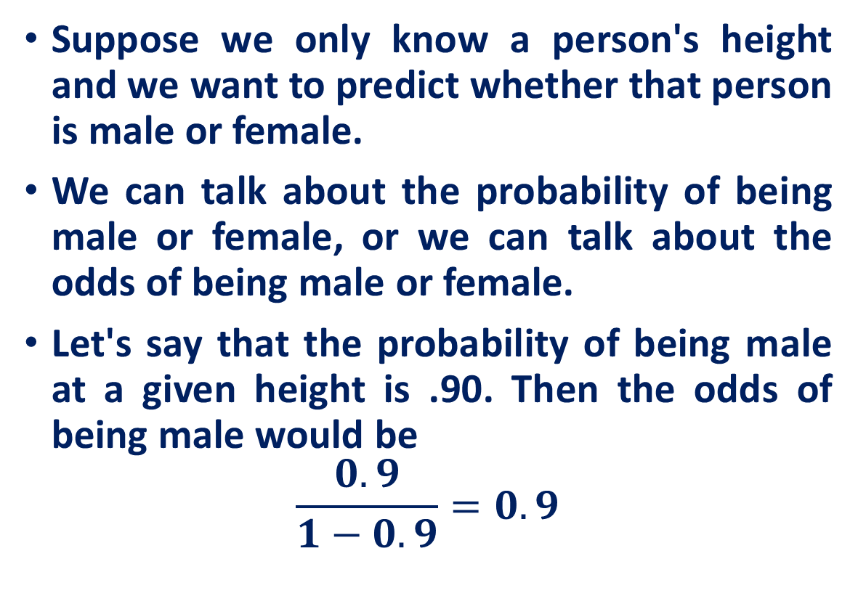
Asymmetry in Odds
Suppose we only know a person's height and we want to predict whether that person is male or female.
We can talk about the probability of being male or female, or we can talk about the odds of being male or female.
Let's say that the probability of being male at a given height is .90. Then the odds of being male would be
$$\frac{0.9}{1−0.9}=0.9$$

Slide 4
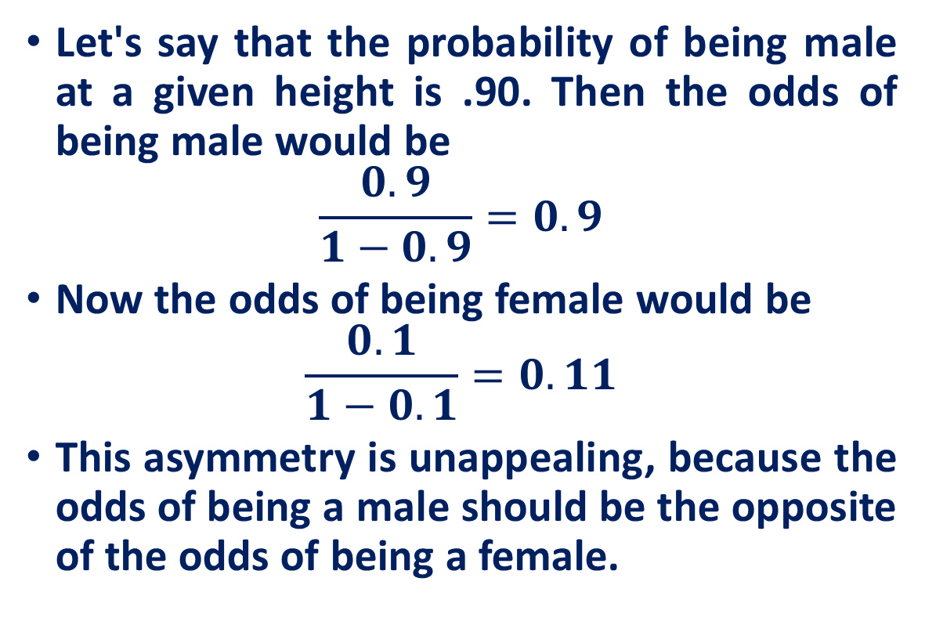
Asymmetry in Odds
Let's say that the probability of being male at a given height is .90. Then the odds of being male would be
$$\frac{0.9}{1−0.9}=0.9$$
Now the odds of being female would be
$$\frac{0.1}{1−0.1}=0.11$$
This asymmetry is unappealing, because the odds of being a male should be the opposite of the odds of being a female.

Slide 5
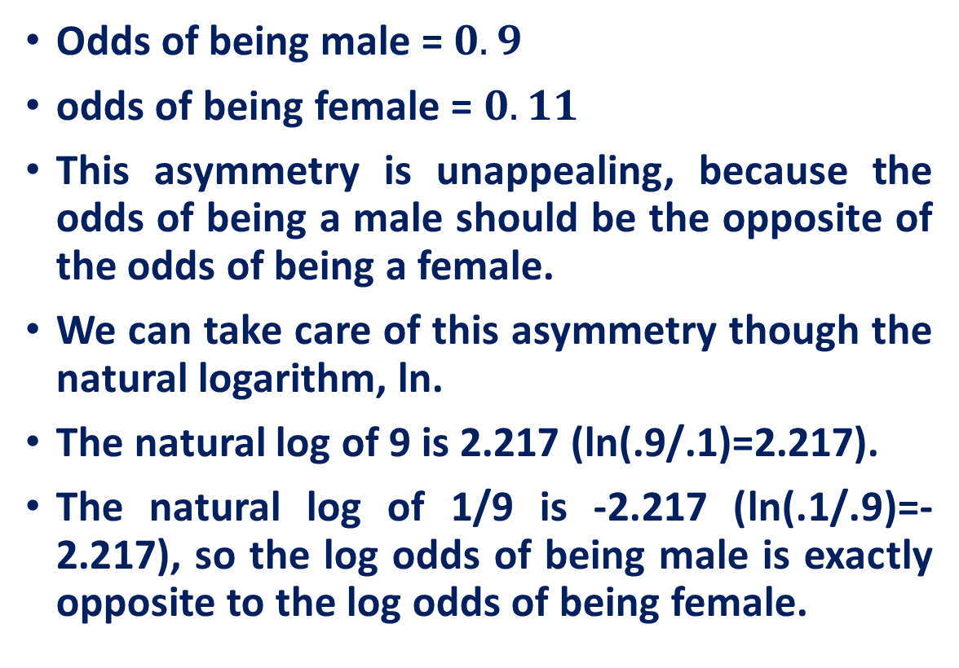
log-odds
Odds of being male = $0.9$
odds of being female = $0.11$
This asymmetry is unappealing, because the odds of being a male should be the opposite of the odds of being a female.
We can take care of this asymmetry though the natural logarithm, ln.
The natural log of 9 is 2.217 (ln(.9/.1)=2.217).
The natural log of 1/9 is -2.217 (ln(.1/.9)=-2.217), so the log odds of being male is exactly opposite to the log odds of being female.

Slide 6
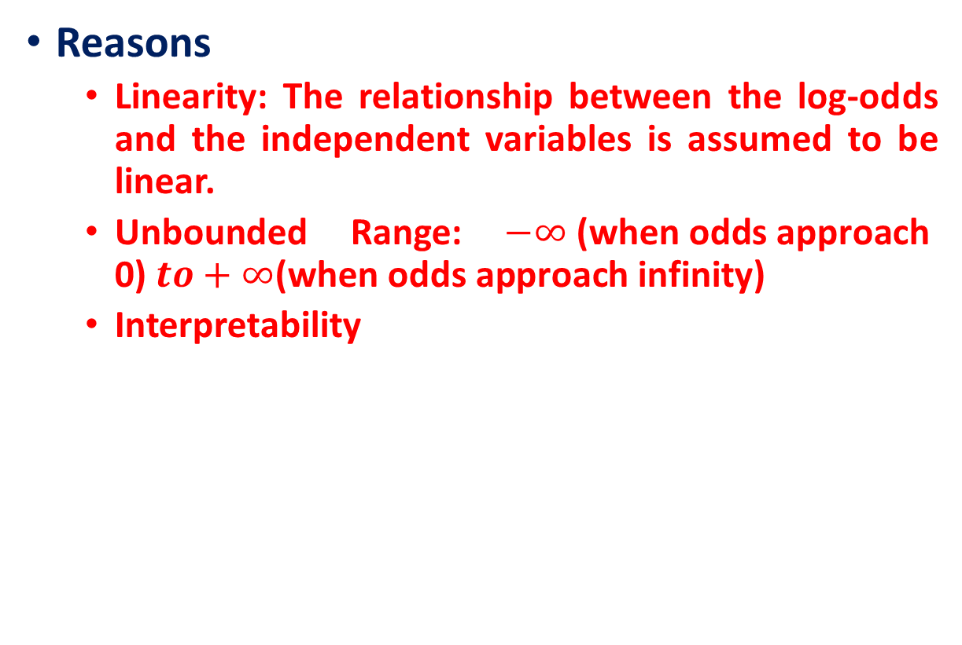
log-odds
Reasons
Linearity: The relationship between the log-odds and the independent variables is assumed to be linear.
Unbounded Range: $−∞ \text{(}\text{when} \text{odds} \text{approach}\text{ 0)} to+∞\text{(}\text{when} \text{odds} \text{approach} \text{infinity}\text{)}$
Interpretability

Slide 7
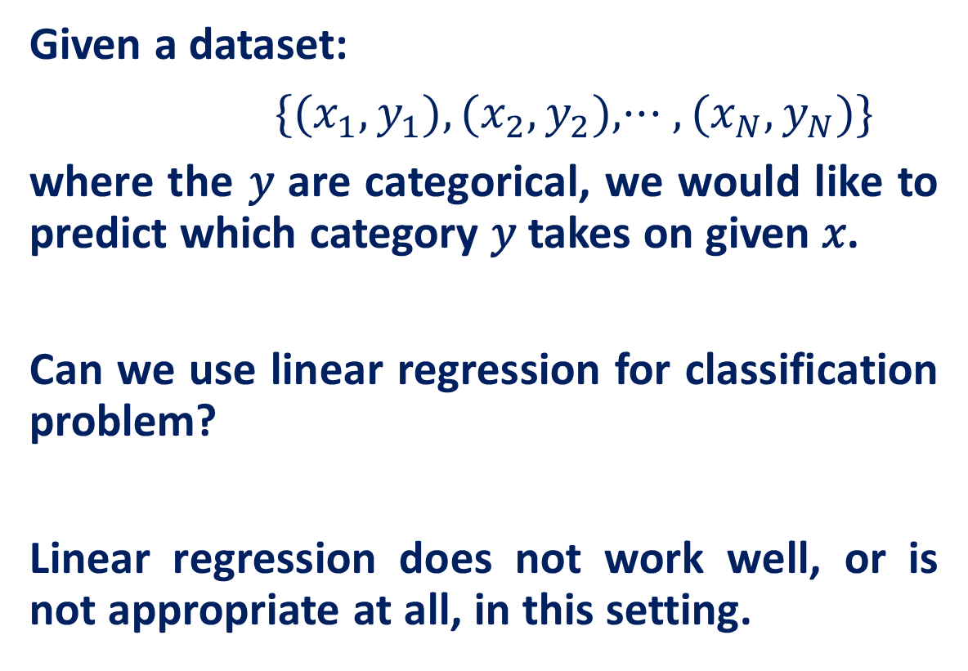
Logistic Regression
Given a dataset:
$\{(x_{1},y_{1}),(x_{2},y_{2}),··· ,(x_{N},y_{N})\}$
where the 𝑦 are categorical, we would like to predict which category 𝑦 takes on given 𝑥.
Can we use linear regression for classification problem?
Linear regression does not work well, or is not appropriate at all, in this setting.

Slide 8
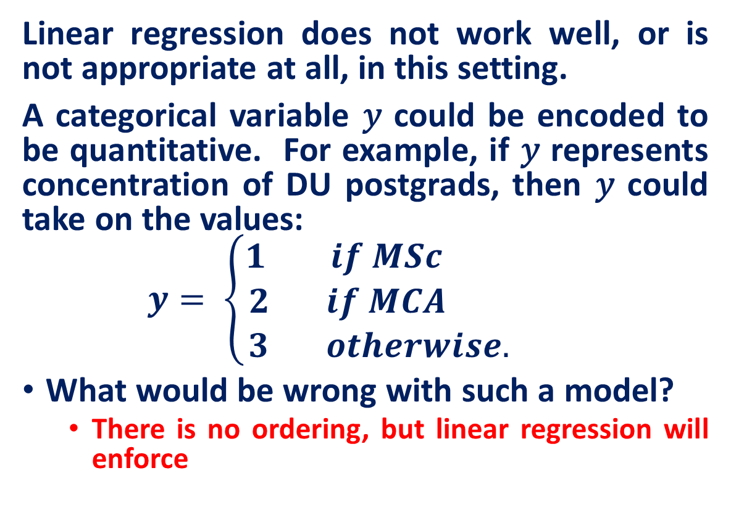
Logistic Regression
Linear regression does not work well, or is not appropriate at all, in this setting.
A categorical variable 𝑦 could be encoded to be quantitative. For example, if 𝑦 represents concentration of DU postgrads, then 𝑦 could take on the values:
$$y= \left\{\begin{aligned}1 if MSc \\ 2 if MCA \\ 3 otherwise. \end{aligned}\right.$$
What would be wrong with such a model?
There is no ordering, but linear regression will enforce

Slide 9
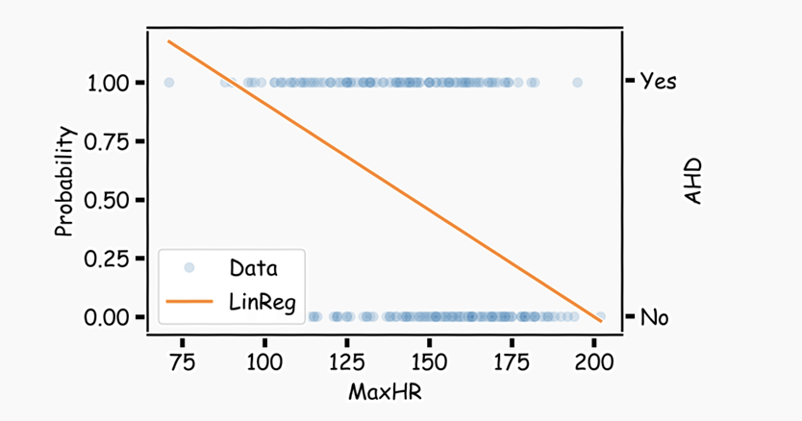
Logistic Regression
What if the outcome are probability?
The main issue is you could get non-sensical values for 𝑦. Since this is modeling 𝑃(𝑦=1) , values for ​𝑦 below 0 and above 1 would be at odds with the natural measure for 𝑦. Linear regression can lead to this issue.

Slide 10
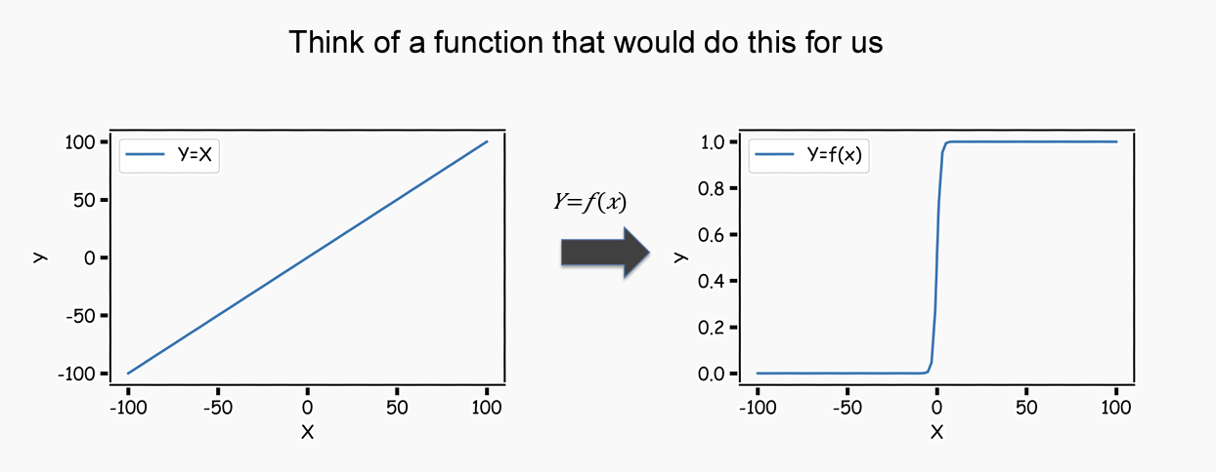
Binary Response & Logistic Regression
Link Function?

Slide 11
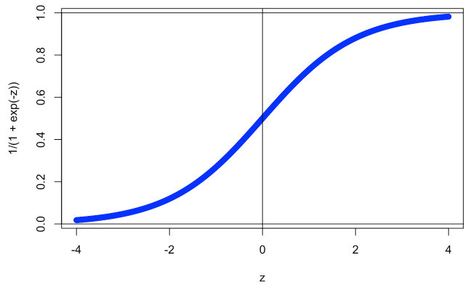
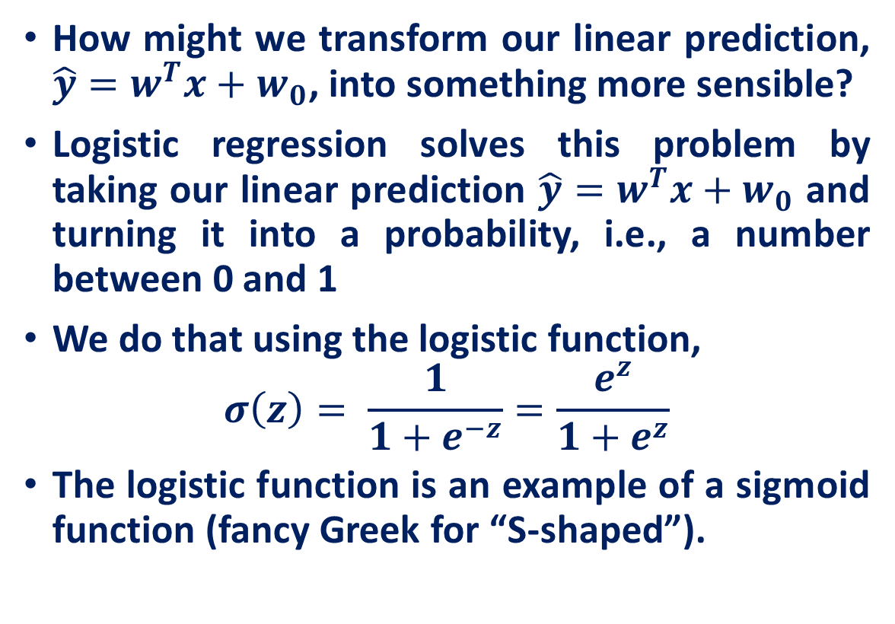
Binary Response & Logistic Regression
How might we transform our linear prediction, $\hat{y}=w^{T}x+w_{0}$, into something more sensible?
Logistic regression solves this problem by taking our linear prediction $\hat{y}=w^{T}x+w_{0}$ and turning it into a probability, i.e., a number between 0 and 1
We do that using the logistic function,
$$σ\left(z\right)= \frac{1}{1+e^{−z}}=\frac{e^{z}}{1+e^{z}}$$
The logistic function is an example of a sigmoid function (fancy Greek for “S-shaped”).

Slide 12
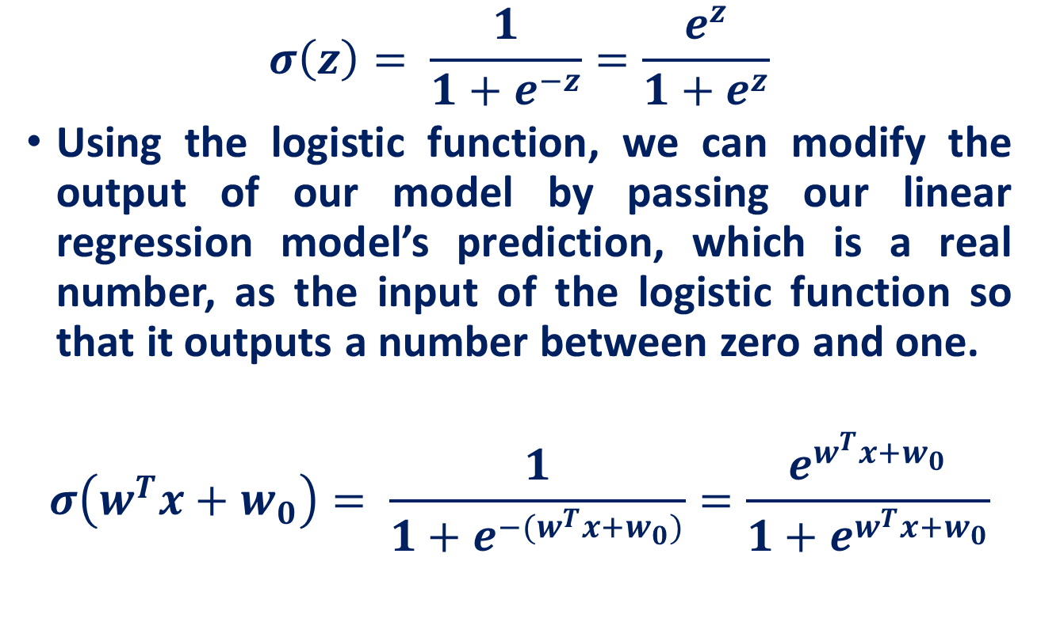
Binary Response & Logistic Regression
$$σ\left(z\right)= \frac{1}{1+e^{−z}}=\frac{e^{z}}{1+e^{z}}$$
Using the logistic function, we can modify the output of our model by passing our linear regression model’s prediction, which is a real number, as the input of the logistic function so that it outputs a number between zero and one.
$$σ\left(w^{T}x+w_{0}\right)= \frac{1}{1+e^{−(w^{T}x+w_{0})}}=\frac{e^{w^{T}x+w_{0}}}{1+e^{w^{T}x+w_{0}}}$$

Slide 13
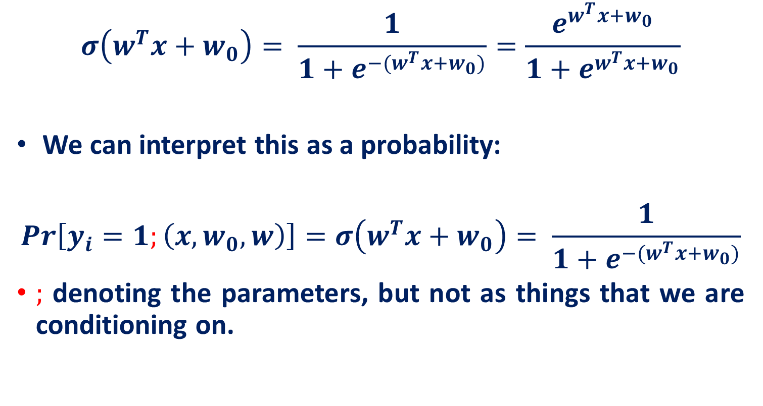
Binary Response & Logistic Regression
$$σ\left(w^{T}x+w_{0}\right)= \frac{1}{1+e^{−(w^{T}x+w_{0})}}=\frac{e^{w^{T}x+w_{0}}}{1+e^{w^{T}x+w_{0}}}$$
We can interpret this as a probability:
$$Pr\left[y_{i}=1;\left(x,w_{0},w\right)\right]=σ\left(w^{T}x+w_{0}\right)= \frac{1}{1+e^{−(w^{T}x+w_{0})}}$$
$;$ denoting the parameters, but not as things that we are conditioning on.

Slide 14
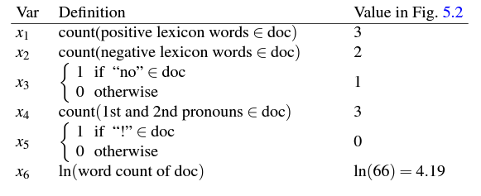
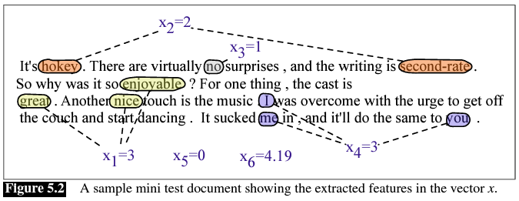
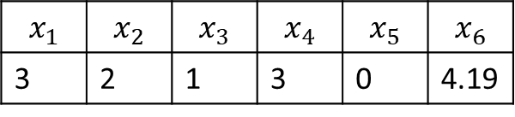
Example: Sigmoid as Probability
$$x_{1}$$ | $$x_{2}$$ | $$x_{3}$$ | $$x_{4}$$ | $$x_{5}$$ | $$x_{6}$$
3 | 2 | 1 | 3 | 0 | 4.19

Slide 15
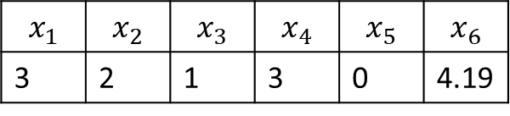

Example: Sigmoid as Probability
Assume: We have learned the weight and bias as
$$w= \left[2.5,−5.0,−1.2,0.5,2.0,0.7\right], b=0.1$$
$$x_{1}$$ | $$x_{2}$$ | $$x_{3}$$ | $$x_{4}$$ | $$x_{5}$$ | $$x_{6}$$
3 | 2 | 1 | 3 | 0 | 4.19

Slide 16
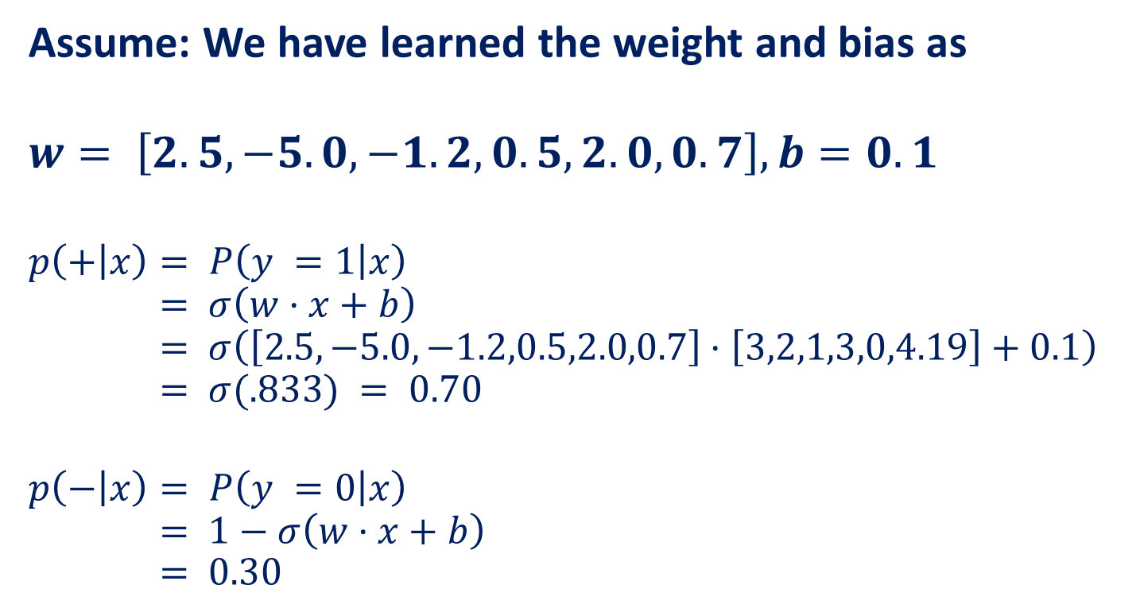
Example: Sigmoid as Probability
Assume: We have learned the weight and bias as
$$w= \left[2.5,−5.0,−1.2,0.5,2.0,0.7\right], b=0.1$$
$$p\left(+ | x\right)= P\left(y =1 | x\right)$$
$$= σ\left(w·x+b\right)$$
$$= σ\left(\left[2.5,−5.0,−1.2,0.5,2.0,0.7\right]·\left[3,2,1,3,0,4.19\right]+0.1\right)$$
$$= σ(.833) = 0.70$$
$$p\left(− | x\right)= P\left(y =0 | x\right)$$
$$= 1−σ\left(w·x+b\right)$$
$$= 0.30$$
$$x_{1}$$ | $$x_{2}$$ | $$x_{3}$$ | $$x_{4}$$ | $$x_{5}$$ | $$x_{6}$$
3 | 2 | 1 | 3 | 0 | 4.19

Slide 17

Logistic Regression: The Logit Transformation
$$⇒ σ\left(z\right)= \frac{1}{1+e^{−z}}$$
$$⇒σ\left(z\right)= \frac{e^{z}}{1+e^{z}}$$
$$⇒σ\left(z\right)\left(1+e^{z}\right)=e^{z}$$
$$⇒σ\left(z\right)=e^{z}\left(1−σ\left(z\right)\right)$$
$$⇒e^{z}= \frac{σ\left(z\right)}{1−σ\left(z\right)}$$

Slide 18
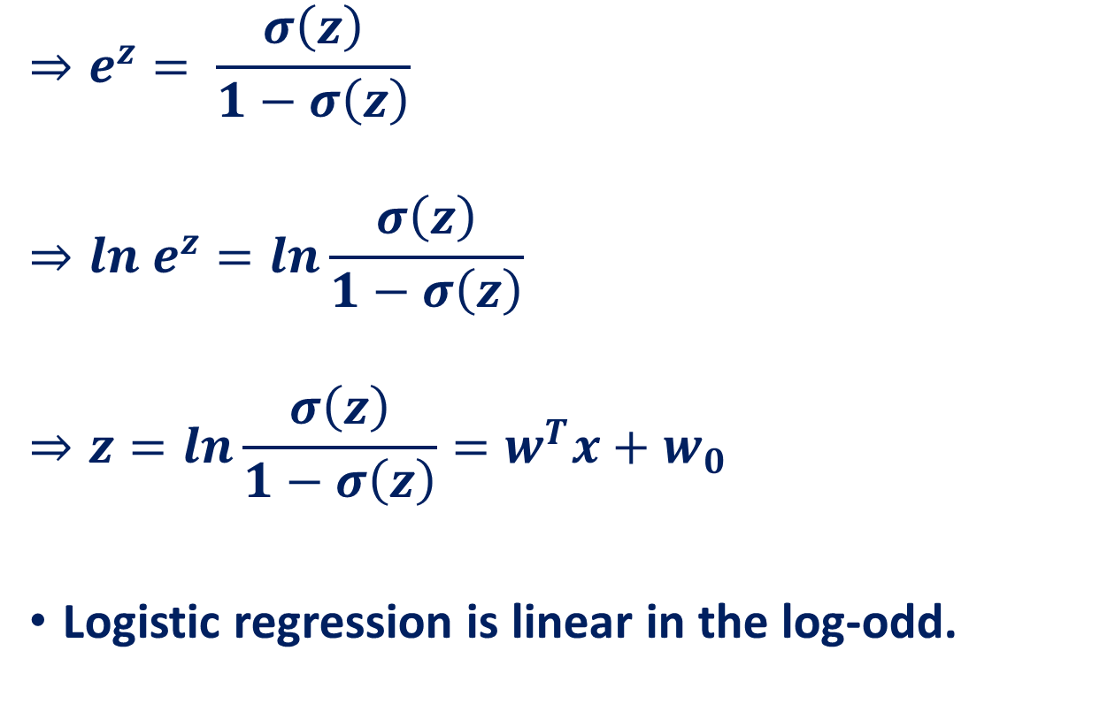
Logistic Regression: The Logit Transformation
$$⇒e^{z}= \frac{σ\left(z\right)}{1−σ\left(z\right)}$$
$$⇒ln e^{z}=ln\frac{σ\left(z\right)}{1−σ\left(z\right)}$$
$$⇒z=ln\frac{σ\left(z\right)}{1−σ\left(z\right)}=w^{T}x+w_{0}$$
Logistic regression is linear in the log-odd.

Slide 19
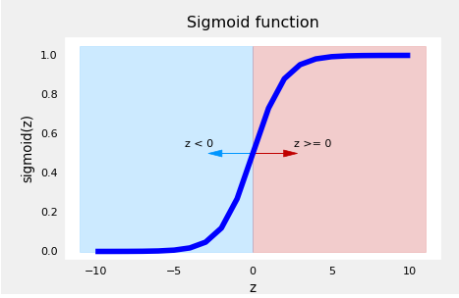
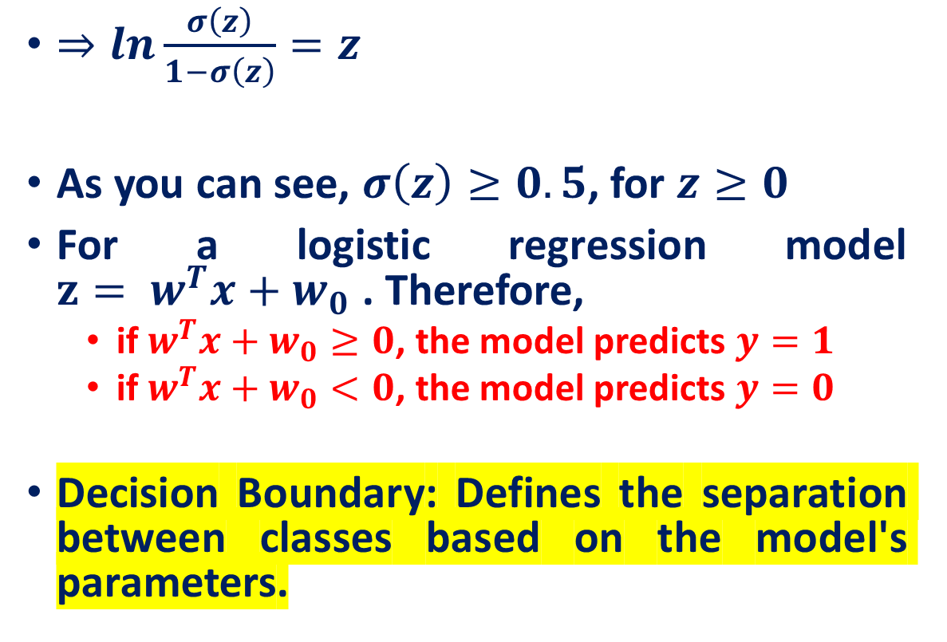
Decision Boundary of Logistic Regression
$⇒ln\frac{σ\left(z\right)}{1−σ\left(z\right)}=z$
As you can see, $σ\left(z\right)≥0.5$, for $z≥0$
For a logistic regression model $z= w^{T}x+w_{0}$ . Therefore,
if $w^{T}x+w_{0}≥0$, the model predicts $y=1$
if $w^{T}x+w_{0}<0$, the model predicts $y=0$
Decision Boundary: Defines the separation between classes based on the model's parameters.

Slide 20
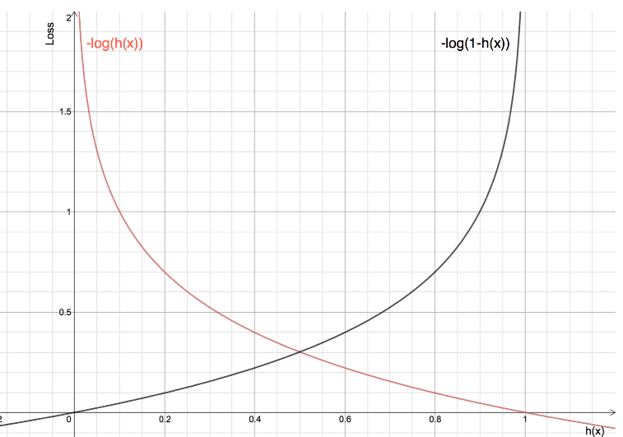
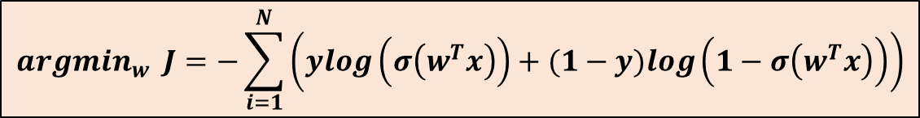
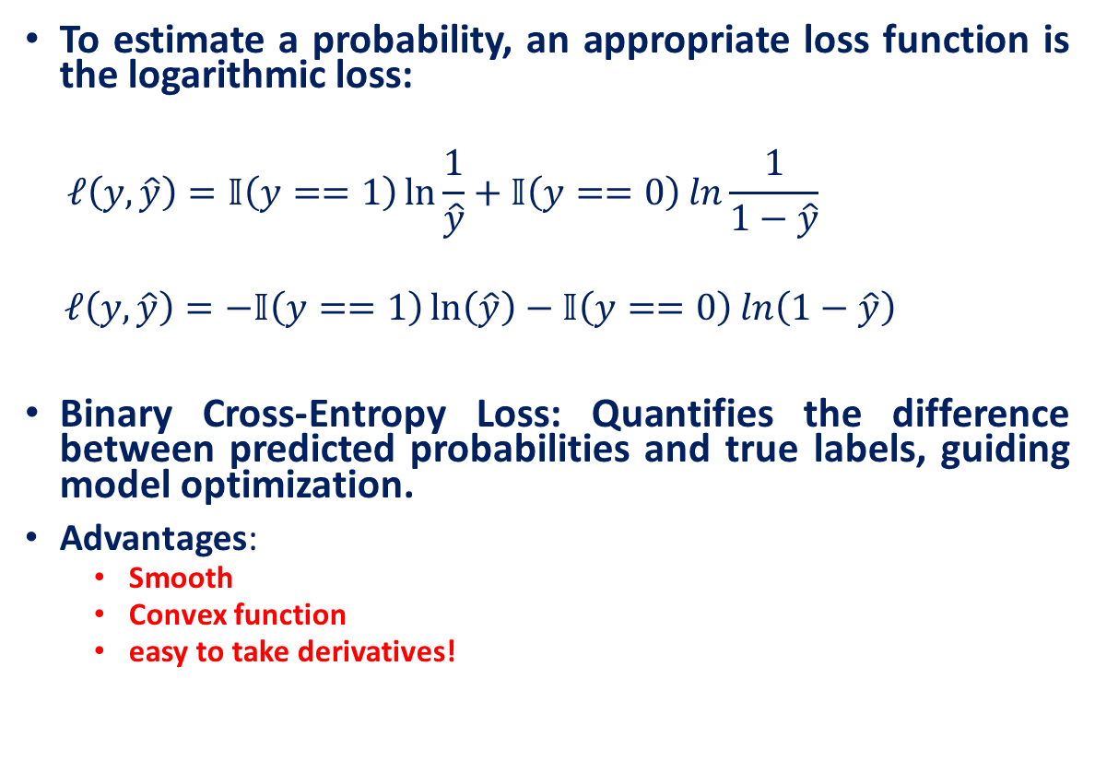
Estimating a probability through loss function
To estimate a probability, an appropriate loss function is the logarithmic loss:
$$ℓ\left(y,\hat{y}\right)=𝕀\left(y==1\right)\ln{\frac{1}{\hat{y}}}+𝕀\left(y==0\right)\ln{\frac{1}{1−\hat{y}}}$$
$$ℓ\left(y,\hat{y}\right)=−𝕀\left(y==1\right)\ln\left(\hat{y}\right)−𝕀\left(y==0\right)\ln\left(1−\hat{y}\right)$$
Binary Cross-Entropy Loss: Quantifies the difference between predicted probabilities and true labels, guiding model optimization.
Advantages:
Smooth
Convex function
easy to take derivatives!
Optimization: Logistic Regression
$${argmin}_{w} J=−\sum_{i=1}^{N}{\left(ylog\left(σ\left(w^{T}x\right)\right)+(1−y)log\left(1−σ\left(w^{T}x\right)\right)\right)}$$

Slide 21
References
Lecture 2: Deep Learning Fundamentals by Serena Yeung
Logistic Regression: https://web.stanford.edu/~jurafsky/slp3/5.pdf

